Slide 1


Modeling Wind-Solar-Microgrid-EV System in GAMS
26th June 2022
Presented by:
Dr. Muhammad Nurariffudin
Universiti Teknologi Malaysia (UTM)

Slide 2
Objectives of this workshop
To learn about wind turbine system and its associated microgrid components.
To apply the developed mathematical models for the evaluation of wind energy case studies.
To apply the developed mathematical models for the evaluation of the integrated wind and solar energy case studies.

Slide 3

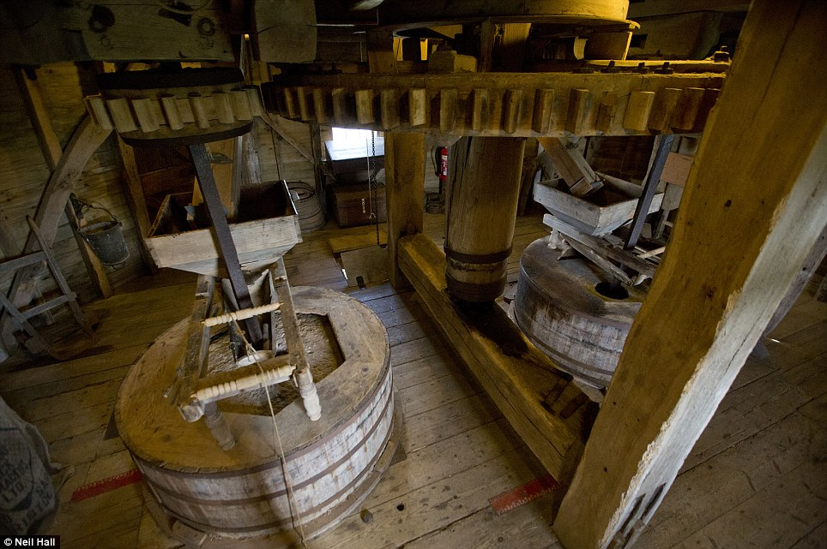
Introduction: What is Wind Energy?
Historically – windmill - used wind to grind/mill grain - name stuck - even when used for other tasks - pumping water.
More general term - machine that uses rotors or blades to convert wind energy into mechanical energy - wind turbine.
Modern wind machines usually used to generate electricity - instead of grinding grain or pumping water.

Slide 4
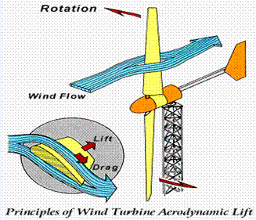
WIND TURBINES
How Wind Turbines Work
Because curve of upper surface of wing, air has to flow faster to get around the wind.
At same time, air flows at lower speed along bottom surface of the wing.
Because of difference in speed, air above wing - less dense - air pressure lower than pressure of air below wing
∆P creates lift perpendicular to direction of moving air, allowing plane to fly - same principle for turbine blades.
Unlike airplane wings, wind turbine wings are almost always twisted.

Slide 5
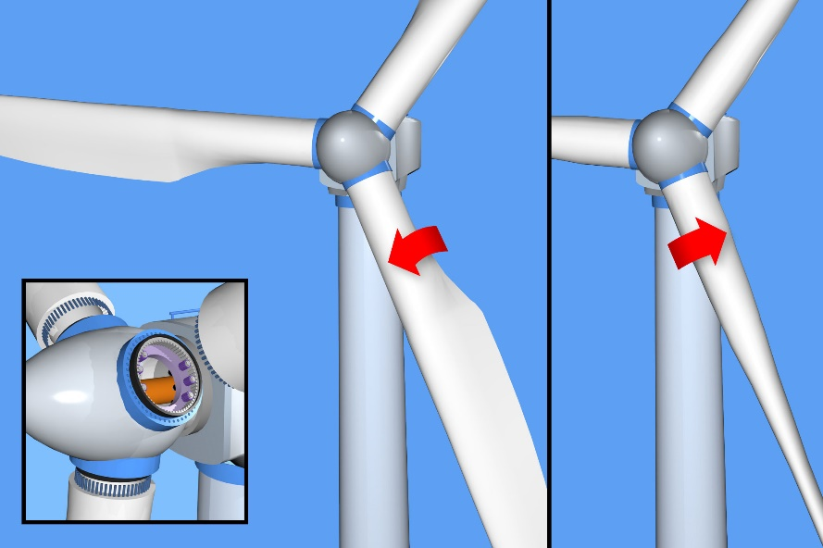
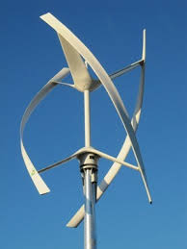
WIND TURBINES
How Wind Turbines Work
When blade twisted - angle at which wind hits
blade is same at each point, and stall is eliminated
under normal wind conditions.
Excessively high wind speeds can damage rotors – but engineers designed blades that stall when wind is too strong & rotor stops spinning.
Wind turbines – 2 configurations – vertical axis turbine - looks like oversized eggbeater.
Axis of turbine positioned vertically and blades connected to axis at top and bottom.
Configuration - primary advantage: turbine does not have to be faced into or away from wind

Slide 6
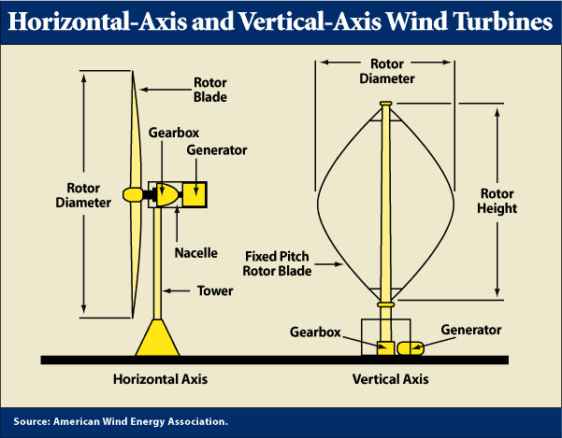
WIND TURBINES
How Wind Turbines Work
So it operates no matter which way wind is blowing and does not have to be repositioned to accommodate changes in wind direction.
Other configuration - horizontal-axis turbine - commonly used.
Axis is parallel to ground on a tower, and blades - look like airplane propellers - perpendicular to axis - wind turbine looks like pinwheel.
Components of wind turbine:
Rotor and blades – rotor – hub around which
blades are connected.

Slide 7
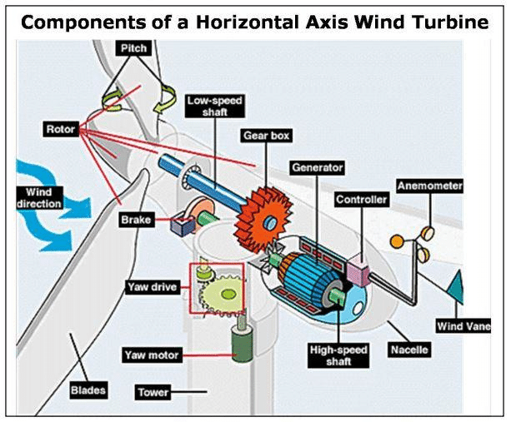
WIND TURBINES
How Wind Turbines Work
Often "rotor" - used to refer to hub & blades as single unit.
Rotor - key component - translates wind's kinetic energy into torque (turning power).
Nacelle - enclosure that houses turbine's drive train, including gearbox, the yaw mechanism, and electric generator.
Gearbox connects a low -speed shaft to a high-speed shaft.
Mechanism can increase speed of shafts by a factor of 50 to 1 – meaning high-speed shaft
turns 50x faster than low-speed shaft.

Slide 8
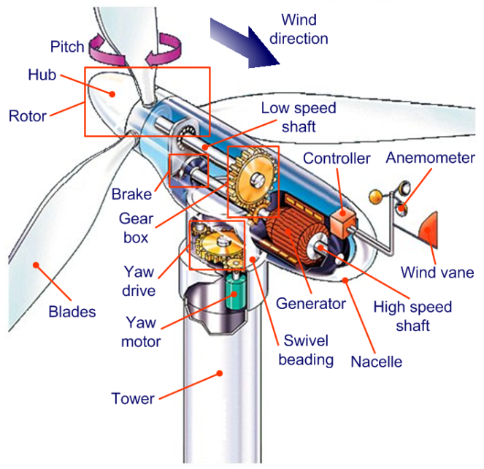
WIND TURBINES
How Wind Turbines Work
Yaw mechanism - automatically senses direction
of wind & rotates rotor to keep facing direction of wind.
Tower - support for rotor & drive train.
Electric equipment - controls, cables, anemometer, electrical generator that converts mechanical energy of blades into electricity.
Blades - various sizes, tended to grow over the years for commercial wind turbines.
Early 80s - typical blade for commercial wind power production - 10 m long - could generate 45 kWh/year.

Slide 9
Vertical Axis Wind Turbines
The Vertical Axis Wind Turbine (VAWT) is the most popular of the turbines that people are adding to make their home a source of renewable energy.
While it is not as commonly used as the Horizontal Axis Wind Turbine, they are great for placement at residential locations and more.
Vertical turbines spin on the vertical axis and comes in various shapes sizes and colors.
The main difference between the VAWT and HAWT is the position of blades.
In HAWT, blades are on the top, spinning in the air while in VAWT, generator is mounted at the base of the tower and blades are wrapped around the shaft.

Slide 10
What is a Vertical Axis Turbine?
Vertical turbines spin on the vertical axis and comes in various shapes sizes and colors.
The main difference between the VAWT and HAWT is the position of blades.
In HAWT, blades are on the top, spinning in the air while in VAWT, generator is mounted at the base of the tower and blades are wrapped around the shaft.
There are two different styles of vertical wind turbines out there.
One is the Savonius rotor
and the second is the Darrieus model.
Most of the wind turbines being used today are the Savonius models.

Slide 11
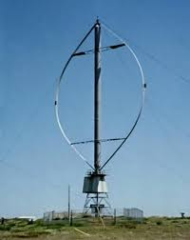
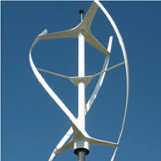
Darrieus Wind Turbine
The Darrieus wind turbine offers the following features:
These eggbeater shaped turbines are great at efficiency, however, they are not as reliable.
In order to use the Darrieus wind turbine you must have an outside source of power in order to start them
It is in your best interest to choose a wind turbine that has at least three blades.
To support such a wind turbine it is necessary that you have a superstructure which will connect it near the top bearing.

Slide 12
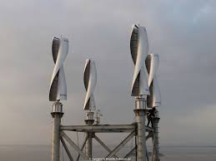
Savonius Wind Turbine
A Savonius vertical-axis wind turbine is a slow rotating, high torque machine with two or more scoops and are used in high-reliability low-efficiency power turbines.
Most wind turbines use lift generated by airfoil-shaped blades to drive a rotor
the Savonius uses drag and therefore cannot rotate faster than the approaching wind speed.

Slide 13
DARRIEUS VS SAVONIUS

Slide 14
ADVANTAGE OF VAWT vs HAWT
You can build your wind turbine close to the ground so if you do not have a suitable rooftop for placement, or if you live where there are hills that prohibit the flow of air, they work wonderfully for your needs.
VAWT are mounted closer to the ground they make maintenance easier,, are more bird friendly and does not destroy the wildlife. Suitable for location where tall structures are not allowed
You do not need any mechanisms in order to operate the wind turbine
Lower wind start-up speed
The main advantage of VAWT is it does not need to be pointed towards the wind to be effective. They can be used on the sites with high variable wind direction.
VAWT’s are quiet, efficient, economical and perfect for residential energy production, especially in urban environments.

Slide 15
DISADVANTAGE OF VAWT vs HAWT
Decreased level of efficiency when compared to the HAWT. The reason for the reduced amount of efficiency is usually due to the drag that occurs within the blades as they rotate.
You are unable to take advantage of the wind speeds that occur at higher levels.
VAWT’s are very difficult to erect on towers, which means they are installed on base, such as ground or building.

Slide 16
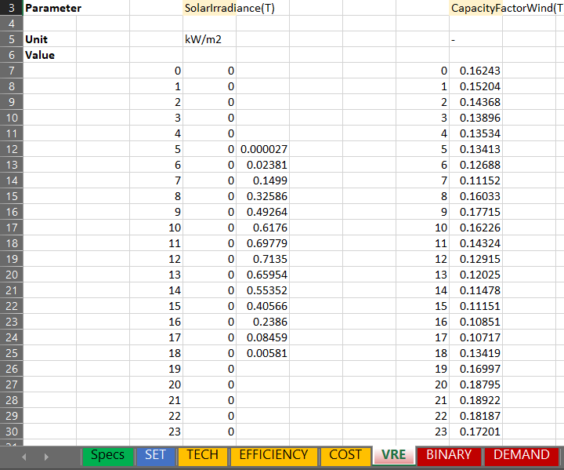
Hands-On Session
In the previous session, we have learned on how to use the Excel as an interface for GAMS software on Solar PV analysis.
For today’s session, we will apply the Microgrid Optimization Tool to assess wind and integrated wind-solar microgrid system.
Similar case study used in the previous workshop will be used for this session, utilizing Thailand as a case.
Download the attached model’s files in the chat box. This version is similar to the previous version, but with corrections on some typographical errors in Excel and GAMS model.
This version also has wind availability data filled in the TECH tab. Note that solar data is removed to assess the wind case.
Now, let’s try running the model.

Slide 17
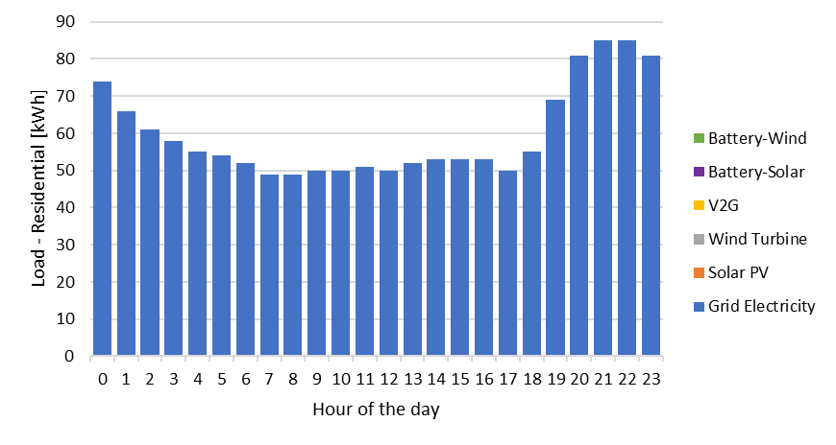
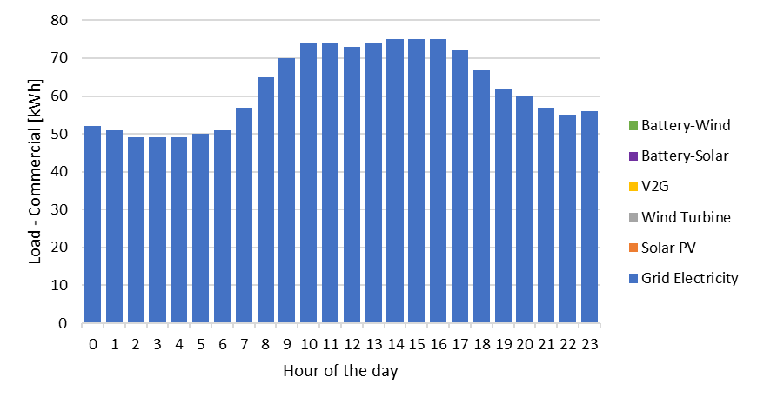
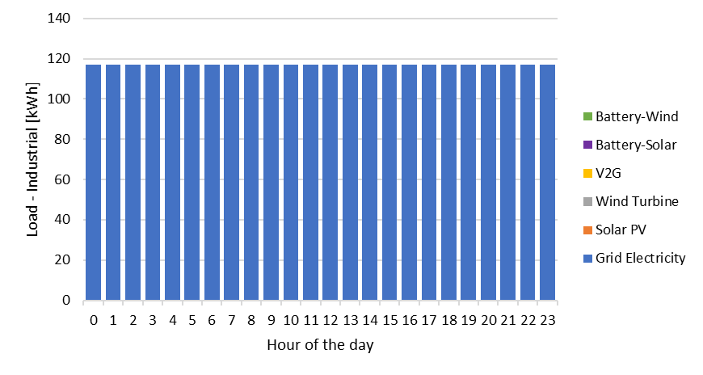
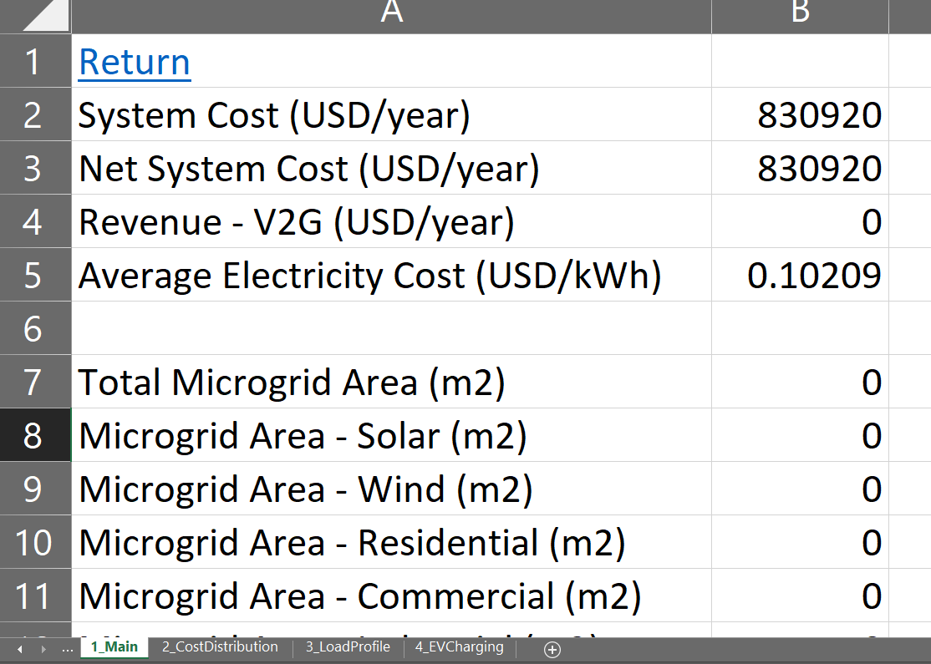
Hands-On Session: Wind Case
What did you see from the results?
Wind is not selected in the mix, meaning that it is not competitive to be deployed in a standalone mode (or at least in the assessed case study location).

Slide 18
Hands-On Session: Wind Case
From the model’s perspective, how can we introduce wind in the results?
This can be done by lowering its capital cost (CAPEX).
Now, for the first exercise, let’s try running the model with reduced CAPEX. You are requested to generate results using the wind CAPEX at 1800 USD/kW (original), 1500 USD/kW, 1000 USD/kW, 500 USD/kW, and 0 USD/kW.
Wind Penetration
(%)
Average Electricity Cost (USD/kWh)
Grid electricity only
0.1
Wind CAPEX (USD/kW)
Wind CAPEX (USD/kW)
0
500
1000
1500
1800
0
500
1000
1500
1800

Slide 19
Hands-On Session: Wind Case
Results from different Wind CAPEX runs:

Slide 20
Hands-On Session: Wind Case
Results from different Wind CAPEX runs:
Grid electricity only
CAPEX (USD/kW) | Wind Penetration (%) | Average Electricity Cost (USD/kWh)
0 | 78.3 | 0.051722464
500 | 65.2 | 0.07421675
1000 | 55.1 | 0.091713973
1500 | 31.8 | 0.101506486
1800 | 0 | 0.102090869

Slide 21
Hands-On Session: Wind Case
Results from different Wind CAPEX runs:
Wind CAPEX: 1800 USD/kW
Wind CAPEX: 1500 USD/kW
Wind CAPEX: 1000 USD/kW
Wind CAPEX: 500 USD/kW
Wind CAPEX: 0 USD/kW

Slide 22
Hands-On Session: Wind Case
Based from the results in the previous workshop on Solar PV case, most of the EV charging is contributed by grid electricity. But how about the wind case?
Wind CAPEX: 1800 USD/kW
Wind CAPEX: 1500 USD/kW
Wind CAPEX: 1000 USD/kW
Wind CAPEX: 500 USD/kW
Wind CAPEX: 0 USD/kW

Slide 23
Hands-On Session: Wind Case
From the previous results, it can be observed that the contribution of battery is very limited even in the case where wind CAPEX is 0.
Now, for the second exercise, let’s try to assess the battery contribution in meeting electricity demand. You are requested to generate results using the battery CAPEX-Energy at 1) 380 USD/kWh (original), 2) 200 USD/kWh, 3) 100 USD/kWh, 4) 50 USD/kWh, and 5) 0 USD/kWh, and battery CAPEX-Power at 1) 360 USD/kW, (original), 2) 200 USD/kW, 3) 100 USD/kW, 4) 50 USD/kW, and 5) 0 USD/kW. Note that you need to change both CAPEX-Energy and CAPEX-Power simultaneously according to sequence number for a total of five modeling runs. Use 1500 USD/kW for wind CAPEX.
Wind Penetration
(%)
Average Electricity Cost (USD/kWh)
Grid electricity only
0.1
Wind CAPEX (USD/kW)
Wind CAPEX (USD/kW)
0
500
1000
1500
1800
0
500
1000
1500
1800

Slide 24
Hands-On Session: Wind Case
Results from different Battery CAPEX runs:

Slide 25
Hands-On Session: Wind Case
Results from different Battery CAPEX runs:
Grid electricity only
Battery CAPEX (Energy, Power) (USD/kW(h)) | Wind Penetration (%) | Average Electricity Cost (USD/kWh)
(0, 0) | 24.3 | 0.099613622
(50, 50) | 31.2 | 0.101344398
(100, 100) | 31.8 | 0.101506486
(200, 200) | 31.8 | 0.101506486
(380, 360) | 31.8 | 0.101506486

Slide 26
Hands-On Session: Wind Case
Results from different Battery CAPEX runs:
Battery CAPEX: 380 USD/kWh (Energy), 360 USD/kW (Power)
Battery CAPEX: 200 USD/kWh (Energy), 200 USD/kW (Power)
Battery CAPEX: 100 USD/kWh (Energy), 100 USD/kW (Power)
Battery CAPEX: 50 USD/kWh (Energy), 50 USD/kW (Power)
Battery CAPEX: 0 USD/kWh (Energy), 0 USD/kW (Power)

Slide 27
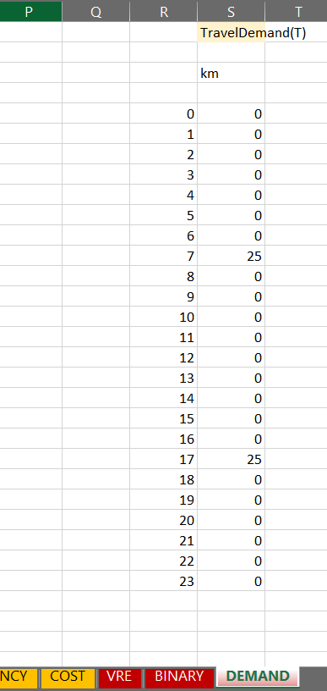
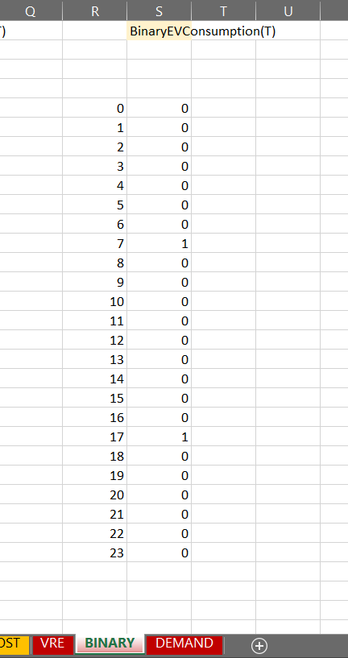
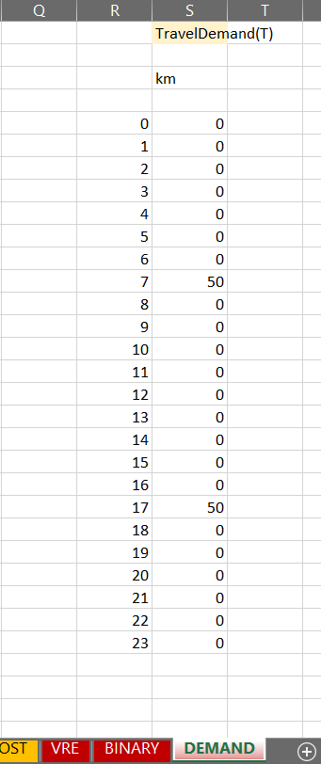
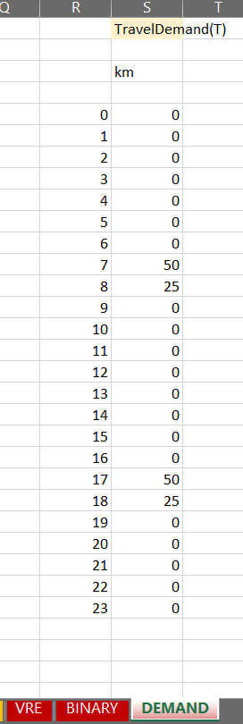
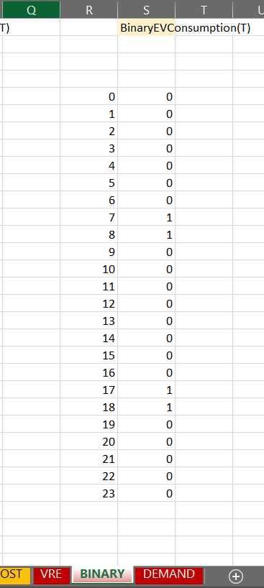
Hands-On Session: Wind Case
Now, for the third exercise, let’s try to assess the impact of EV traveling demand on the wind penetration.
You are requested to generate results using the increasing traveling demand at 50 km (original), 100 km and 150 km.
Before we conduct this exercise, change the wind CAPEX to 1500 USD/km, battery CAPEX-Energy to 380 USD/kWh, and battery CAPEX-Power to 360 USD/kWh.
Instructions to change travel demand:
50 km daily demand (original)
100 km daily demand
150 km daily demand

Slide 28
Hands-On Session: Wind Case
Wind Penetration
(%)
Net system cost (USD/year)
Distance traveled (km)
Distance traveled (km)
50
100
150
50
100
150

Slide 29
Hands-On Session: Wind Case
Results from different EV traveling demand runs:

Slide 30
Hands-On Session: Wind Case
Results from increasing EV traveling demand runs:
Travel Demand (km) | Wind Penetration (%) | Net System Cost (USD/year)
50 | 31.8 | 829470.073
100 | 31.8 | 871788.703
150 | 10.3 | 915091.162

Slide 31
Hands-On Session: Wind Case
50 km daily demand (original)
100 km daily demand
150 km daily demand
Load profile
Load profile
EV Battery State-Of-Charging
EV Battery State-Of-Charging
EV Battery State-Of-Charging

Slide 32
Hands-On Session: Wind Case
Summary of the findings from the wind case:
Penetration levels of VRE are significantly dependent on its investment cost.
In almost all cases, V2G is preferred for supporting demand fulfilment during the peak hours, benefiting from the revenue gained from the higher tariffs during peak hours based on Time-Of-Use (TOU) tariff mechanism.
When VRE such as wind is available throughout the day, even if it fluctuates, the battery energy storage requirement is minimal because the VRE can be tapped directly.
The increase in EV traveling demand causes the EV battery level to be dedicatedly used for the traveling energy, thus reducing the V2G potential in the system.

Slide 33
Hands-On Session: Integrated Solar and Wind Case
In this session, we will adjust the model parameter to allow integrated wind and solar microgrid system.
Before we allow both wind and solar in the model, revert back the EV traveling demand parameter to its original value (based on 50 km daily demand). Please note to use 1500 USD/kW of wind CAPEX instead of 1800 USD/kW.
To allow both wind and solar, add solar irradiation data to its parameter location in Excel as shown in the figure.
Now, let’s run the model.
Transfer to allow integrated case

Slide 34
Hands-On Session: Integrated Solar and Wind Case
What can you see from the results?
No wind selection in the integrated case, showing that cost reduction provided by solar is greater than wind at this CAPEX level.
This means that wind CAPEX needs to be well below than 1500 USD/kW in order for it to be competitive against solar PV.
Integrated Solar and Wind Case at Wind CAPEX of 1500 USD/kW
Solar Case (Results from the Previous Workshop)
Wind Case at Wind CAPEX of 1500 USD/kW

Slide 35
Hands-On Session: Integrated Solar and Wind Case
Although Solar PV is more cost competitive than wind, there is still a significant portion of the demand supported by grid electricity.
Wind could hypothetically help in replacing this grid electricity in the case where off-grid microgrid configuration is promoted.
Thus, given this importance, you are requested to run the model based on off-grid microgrid configuration. So how would you run this scenario?
Clue: This can be performed by changing one of the parameter value located in the top rows of TECH tab.
Exercise 1: Extract the percentages of solar, wind, battery-solar, battery-wind, and V2G in the total load.
Exercise 2: State the percentage differences of the average electricity cost in off-grid case relative to grid-connected solar case and grid-connected wind case.

Slide 36
Hands-On Session: Integrated Solar and Wind Case
Exercise 1: Extract the percentages of solar, wind, battery-solar, battery-wind, and V2G in the total load.
Source | Percentage (%)
Solar
Wind
Battery-Solar
Battery-Wind
V2G
Results (%)
40.9
14.7
40.1
4.1
0.1

Slide 37
Hands-On Session: Integrated Solar and Wind Case
Exercise 2: State the percentage differences of the average electricity cost in off-grid case relative to grid-connected solar case and grid-connected wind case.
+37.9%
Source | Percentage
Off-grid relative to grid-connected solar
Off-grid relative to grid-connected wind
Results (%)
81.1%
37.9%
Solar Case
Wind Case
Wind + Solar Case
0.1400 USD/kWh
0.1015 USD/kWh
0.0773 USD/kWh
+81.1%

